Slide 2
Build Python apps in Azure faster with Visual Studio Code
Nicolas Garfinkel
Program Manager

Slide 3
Reduce Distractions, Improve Productivity
Context switching has real, measurable impact on your development cycles
Efficiency can drop by as much as 40%
Long-term memory & creativity suffers
VS Code helps Developers focus on writing code and less on configuring cloud services
Today’s Session Goal – Learn
VS Code can improve your productivity on Azure
The new Azure Python SDK
5 Azure services & how they can be used with Python
y
[1] Source: https://hbr.org/2010/12/you-cant-multi-task-so-stop-tr

Slide 4
Python is one of the fastest growing languages
Stack Overflow Survey Results:
2016 - 5th most popular coding language
2019 - 2nd most popular coding language after JavaScript
Python is used broadly:
Data processing
Machine Learning
Web Applications

Slide 5





Python on Azure
Python is a first-class language, supported by almost every service
Offers a robust free-trial offering on many of the core services
Services we’ll use in today’s session
Data processing
Azure Functions
Azure Blob Storage
Cosmos DB
Machine learning
Cognitive Services
Web development
Azure App Service
Learn More: https://azure.microsoft.com/python

Slide 6
New Python SDK released on Tuesday
Azure Python SDK completely re-written for ease of use and improved productivity
Consistently written
Idiomatic to Python
Well documented in a single GitHub repo
What’s Available Today?
Generally Available: Storage, Identity, Key Vault
Preview: CosmosDB (GA-Dec), Event Hubs (GA-Dec)
Release Details: aka.ms/SDKrelease
Theater Session: aka.ms/pythonsdktalk

Slide 7
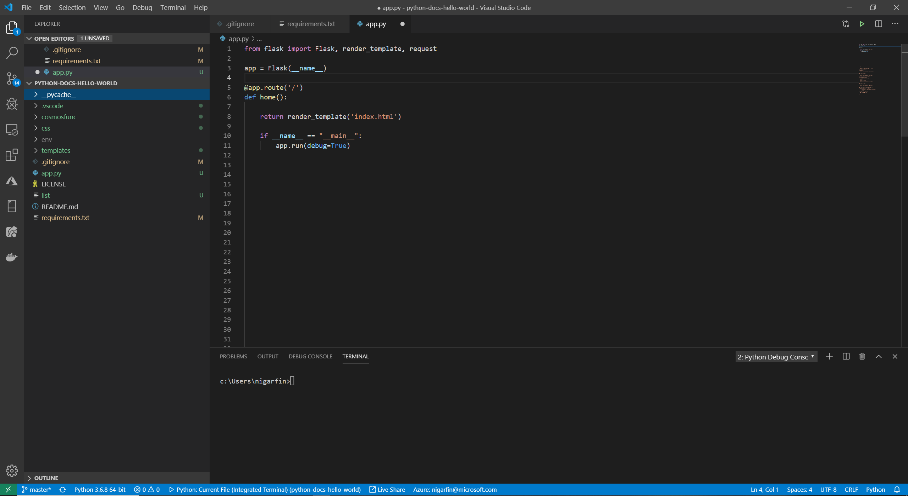
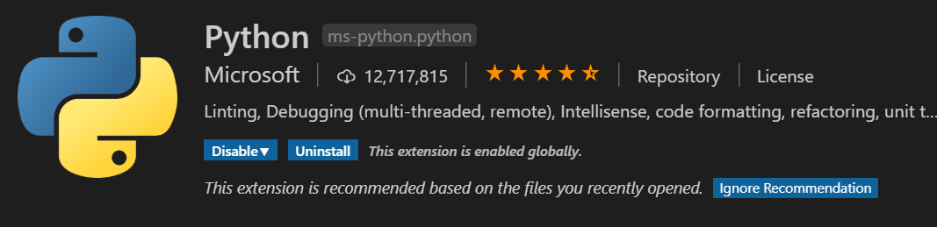
Python with Visual Studio Code
Adds Python Support: IntelliSense, Debugging, Linting, Testing, Refactoring
Most popular extension on the VS Code Marketplace
Fully open source, originally created by the community
New releases every month
Free, cross-platform, open source
Fast and lightweight
Rich extension ecosystem

Slide 8
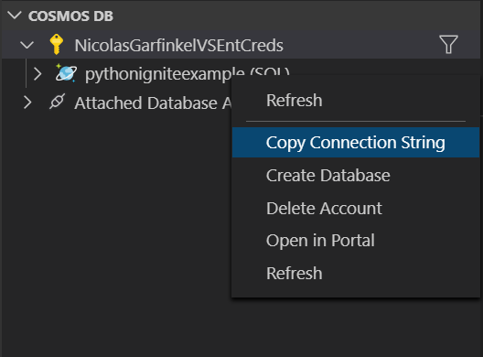
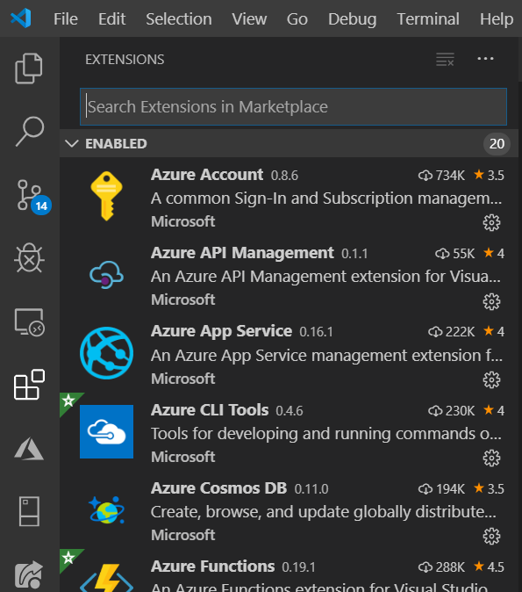
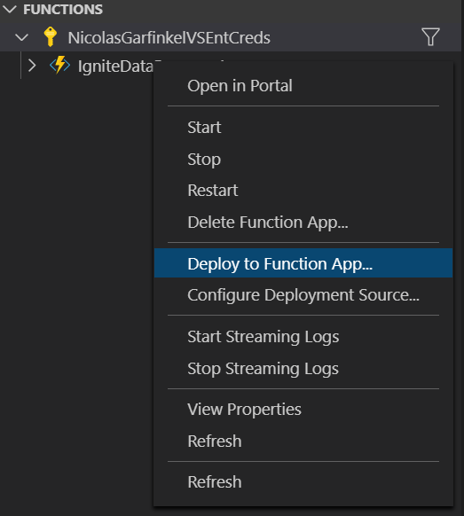
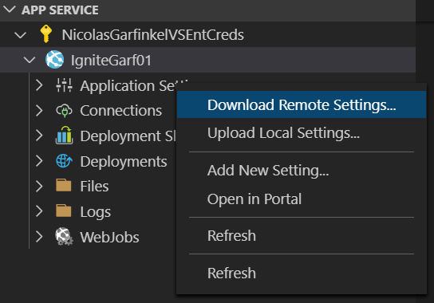
VS Code Integration with Azure => Productivity
CosmosDB
Extensions Tab
Functions
App Services

Slide 9

GitHub ‘Issue’ Visualization
Python App on Azure
Download every issue filed on any public repo in GitHub
Apply ML to extract key phrases from each title
Store data in Azure Database
Visualize/Interact with that data through a WebApp
Data Processing
Machine Learning
Web Applications
Github
Data
CosmosDB
Table #1
CosmosDB
Table #2
Azure Storage
App Services
(Web Hosting)
API
Github
Data
Cognitive Services (ML)
Github
Data

Slide 10
GitHub ‘Issue’ Visualization
Python App on Azure
Download every issue filed on any public repo in GitHub
Apply ML to extract key phrases from each title
Store data in Azure Database
Visualize/Interact with that data through a WebApp
Data Processing
Machine Learning
Web Applications
Github
Data
CosmosDB
Table #1
CosmosDB
Table #2
Azure Storage
App Services
(Web Hosting)
API
Github
Data
Cognitive Services (ML)
Github
Data

Slide 11
Requirements
Code + Slides:
Python 3.6 (python.org/downloads)
Azure Subscription (azure.microsoft.com)
Azure CLI (aka.ms/azcli)
Visual Studio Code (code.visualstudio.com)
VS Code Extensions (Extensions tab in VS Code)
Azure Account
Azure App Service
Azure Functions
Azure Cosmos DB

Slide 12
Data Processing

Slide 13
Data Processing: Azure Functions 101
What is Azure Functions?
Scalable event-driven serverless compute platform that also can solve complex orchestration problems
Common Uses:
Data Science - ML & Data Processing
System Admin - Cloud Automation
Web Developer - APIs, SPAs, Mobile backends
Free-Tier (Monthly)
*1 million requests
*400,000 GB-s of resource consumptions
*Free tier requires a consumption / pay-as-you-go plan.

Slide 14
Functions - VS Code Extension
Create/Deploy functions directly from the VS Code
Powerful debugging feature which speeds up our development cycles
Upload environmental variables directly into Azure

Slide 15
Data Processing Demo ‘Hello World’ Function
Create HTTP ‘Hello World’ Function in VS Code
Add Blob Storage Output Binding

Slide 16
Demo Learnings
Azure Functions in VS Code speed up development significantly
Pre-made templates based on your selected trigger
Right-click deploy
Debugging locally to speed up your developement cycles
Output bindings let you store returned values into other Azure services
Other Bindings: Event Hubs, Cosmos DB, 18+ other Azure services

Slide 17
New Python SDK: Blob Storage
Azure Python SDK completely re-written for ease of use and improved productivity
from azure.storage.blob import BlobClient
# Connection String
connection_string = "DefaultEndpointsProtocol=https;AccountName=<value>;AccountKey=<value>;"
# Connection Client
blob = BlobClient.from_connection_string(
conn_str=connection_string,
container_name="input",
blob_name="MyRecipeList_November2019.txt"
)
# Read file, upload to blob
with open("./RecipeList.txt", "rb") as data:
blob.upload_blob(data)

Slide 18
Today’s App Architecture: Data Proccessing
Step 1: Download, Store into Blob
Call API & Download Hourly Files
Store the files in Azure Blob Storage
Step 2: Unzip, Filter and Store in DB
Unzip & Transform the data into JSON
Filter on event type [New Issue Creation]
Reshape the data
Store in CosmosDB (Table #1)
Azure Storage
CosmosDB
Table #1
CosmosDB
Table #2
App Services
(Web Hosting)
Github
Data
API
Github
Data
Cognitive Services (ML)
Github
Data

Slide 19
Data Processing Demo Step 1 – Call API, Store in Blob
Call API & Download Hourly Files
Store the files in Azure Blob Storage

Slide 20
Demo Learnings
Iterate quickly, testing Function changes locally before deploying to Azure
Output bindings are super convenient, but not required
Python Blob Storage SDK is really easy to use
https://azure.github.io/azure-sdk/python_introduction.html
Idiomatic
Consistent
Approachable
Diagnosable
Dependable.

Slide 21
Data Processing: What we’ve built so far…
Step 1:
Call API & Download Hourly Files
Store the files in Azure Blob Storage
Step 2:
Unzip & Transform the data into JSON
Filter on event type [New Issue Creation]
Reshape the data
Store in CosmosDB (Table #1)
Azure Storage
CosmosDB
Table #1
CosmosDB
Table #2
App Services
(Web Hosting)
Github
Data
API
Github
Data
Cognitive Services (ML)
Github
Data

Slide 22
Data Processing: CosmosDB 101
Cosmos DB:
Globally distributed, multi-model NoSQL database service
Common Uses:
IOT device telemetry & supply chain
Real-time personalization & analytics

Slide 23
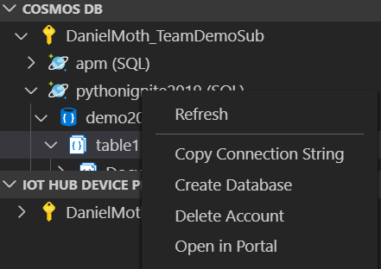

CosmosDB – VS Code Extension
Create CosmosDB accounts, databases & collections (tables)
Grab connection strings/keys
Upload records directly into your tables
View individual records

Slide 24
Today’s App Architecture: Data Proccessing
Step 1: Download, Store into Blob
Call API & Download Hourly Files
Store the files in Azure Blob Storage
Step 2: Unzip, Filter and Store in DB
Unzip & Transform the data into JSON
Filter on event type [New Issue Creation]
Reshape the data
Store in CosmosDB (Table #1)
Azure Storage
CosmosDB
Table #1
CosmosDB
Table #2
App Services
(Web Hosting)
Github
Data
API
Github
Data
Cognitive Services (ML)
Github
Data

Slide 25
Data Processing Demo Step 2 – Unzip, Process and Store in CosmosDB
Unzip & Transform the data into JSON
Filter on event type [‘New Issue’ Creation]
Reshape the data
Store in CosmosDB (Table #1)

Slide 26
Demo Learnings
Easy to create and manage CosmosDB directly from VS Code Ext.
You can also dynamically update throughput to scale with demand inside your function
You can build some powerful data processing pipelines with Azure Functions, Python, VS Code with Blob Storage + CosmosDB
https://azure.github.io/azure-sdk/python_introduction.html
Idiomatic
Consistent
Approachable
Diagnosable
Dependable.

Slide 27
Data Processing: What we’ve built so far…
Step 1:
Call API & Download Hourly Files
Store the files in Azure Blob Storage
Step 2:
Unzip & Transform the data into JSON
Filter on event type [New Issue Creation]
Reshape the data
Store in CosmosDB (Table #1)
Azure Storage
CosmosDB
Table #1
CosmosDB
Table #2
App Services
(Web Hosting)
Github
Data
API
Github
Data
Cognitive Services (ML)
Github
Data

Slide 28
Machine Learning

Slide 29
Today’s App Architecture
Step 3: Apply ML & Store in DB
Extract the key phrases from every issue title using ML
Store in CosmosDB (Table #2)
Azure Storage
CosmosDB
Table #1
CosmosDB
Table #2
App Services
(Web Hosting)
Github
Data
API
Github
Data
Cognitive Services (ML)
Github
Data

Slide 30
Machine Learning: Cognitive Services 101
Cognitive Services
Help developers build intelligent applications without having direct AI or data science skills or knowledge
Vision | Computer Vision (Image Classification, OCR) Face (Face Detection, Emotion Recognition)
Speech | Speech Service (Speech-to-text) Speaker Recognition (Speaker identification)
Language | Text Analytics (Key Phrase Extraction, Sentiment) QnA Maker (QnA extraction from unstructured text)
Decision | Anomaly Detector (Business Health, IoT monitoring) Content Moderator (Profanity, offensive image detection)
Search | Bing Visual Search (Identify similar images and products) Bing Customer Search (Customer search engine creation)

Slide 31
Machine Learning: Cognitive Services API
Example of “Key Phrase Recognition”
"issue_title": "HeadlessTask.java:error: method findAppBundlePath in class FlutterMain cannot be applied to given types[BUG]"
“key_phrase": ["class FlutterMain", "method findAppBundlePath", "error", "types", "BUG“]
Code Example
from msrest.authentication import CognitiveServicesCredentials
from azure.cognitiveservices.language.textanalytics import TextAnalyticsClient
creds = CognitiveServicesCredentials(Cognitive_Key)
text_analytics = TextAnalyticsClient(endpoint=Endpoint, credentials=creds)
response = text_analytics.key_phrases(documents=batch_job)

Slide 32
Machine Learning Demo Step 3 – Apply ML and Store in CosmosDB
Call ‘Azure Cognitive Services’ API
Apply ‘Key Phrase Recognition’ for every record in Table#1
Write to Table#2 where we’ll use for our WebApp to read from

Slide 33
Demo Learnings
Cognitive Services let’s you apply ML to applications with a few lines of code
Combined with Functions, you can create powerful, intelligent applications without the data science degree

Slide 34
What we’ve built so far…
Data Processing
Call API and download hourly files
Unzip, process & store in DB
Machine Learning
Extract Key Phrases from Issue Titles (NLP)
Store in CosmosDB
Azure Storage
CosmosDB
Table #1
CosmosDB
Table #2
App Services
(Web Hosting)
Github
Data
API
Github
Data
Cognitive Services (ML)
Github
Data

Slide 35
Web Applications

Slide 36
Today’s App Architecture
Step 4: Build WebApp to read DB & visualize data
Build a WebApp that can read from the DB using the Python SDK
Visualize the data for any public Repo taking a Repo Name or ID
Azure Storage
CosmosDB
Table #1
CosmosDB
Table #2
App Services
(Web Hosting)
Github
Data
API
Github
Data
Cognitive Services (ML)
Github
Data

Slide 37
Web Application: App Services 101
What is App Service?
build and host web apps, mobile back ends, and RESTful APIs
Key Features
Deploy from CLI, VS Code, Portal (via GitHub and other paths)
Staging Slots so you don’t need to deploy straight to production
Supports both Linux and Windows
Can host an application for free and scale up from there!

Slide 38
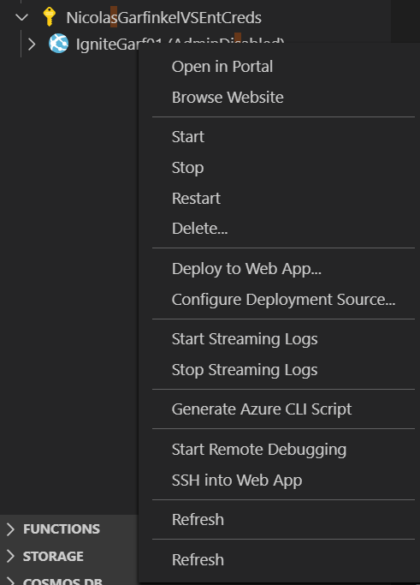
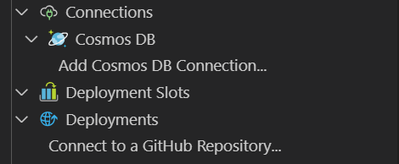
VS CODE EXT – WEB APPS
Create/Deploy Web Apps directly to Azure
Remote Debugging/SSH
Config Deployment Source
Upload Remote Settings

Slide 39
Web Application Demo Step 4 – Build WebApp to read/visualize data
Build a WebApp that can read from the DB using the new Python SDK
Visualize the data for any public Repo taking a Repo Name or ID

Slide 40
Demo Learnings
VS Code’s App Service Extension let’s you create, deploy, and configure your web app without leaving your coding environment!
Using the CosmosDB extension, we can create new containers for our DB and view individual records
Azure App Service let’s us host WebApps without any of the overheard or maintenance

Slide 41
Summary
The new Python SDK is idiomatic and consistent across services
With VS Code, your development cycles are even faster thanks to key integrations
Azure is a powerful cloud for Python applications
Resources
GitHub Repo + Slides aka.ms/ignite2019_pythonvscode
Python blog aka.ms/pythonblog

